Slide 1
Dealing with
Process Uncertainty
Process view
Ops strategy
Waiting line
Transformation Process
Process
Analysis
Manufactur
Proc select
Linear
Program
Project
Nature of service
Service system-design matrix
3 contrasting service designs
Service
design

Slide 2
Waiting line management
Why waiting occurs? What contributes to it?
Performance-productivity tradeoff
Queueing models (Excel spreadsheets)
How to reduce waiting?
Psychology of waiting
Notes:
Queueing: the only word in English with 5 consecutive vowels.

Slide 3
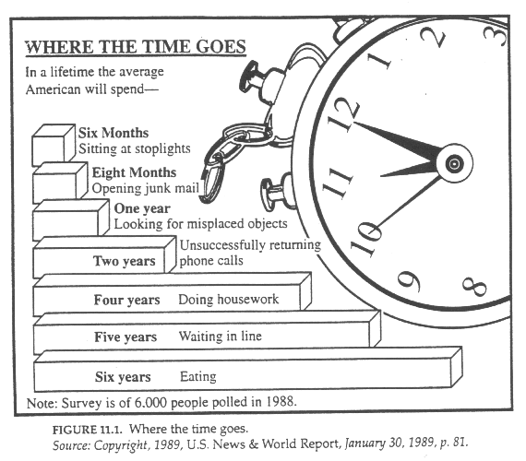
Waiting a Part of Everyday Life

Slide 4
Waiting at Hospitals
As of June 30, 2007, there were 48,000 patients waiting for cataract surgery at Hong Kong public hospitals;
The expected waiting time for cataract surgery is about 35 months;
The information will be revealed publicly by an information system set up by the Hospital Authority to improve transparency and choice.

Slide 5
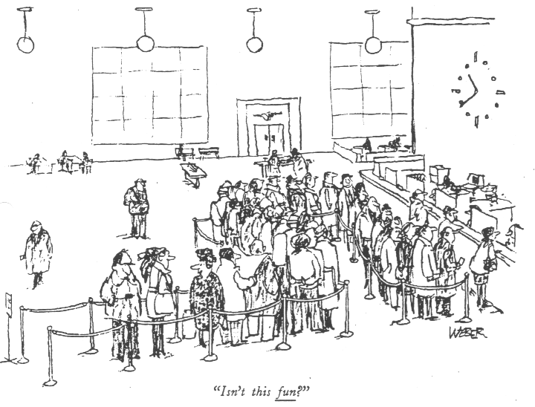
Laughing All The Way

Slide 6


Or Is It Really Fun?
arriving customer
queue
Waiting is frustrating, demoralizing, agonizing, aggravating, annoying, time consuming, and incredibly expensive.
--- Federal Express

Slide 7
Some Waiting-Related Questions
Guests in a five-star hotel complain that they wait too long for lifts. What can you do about it?
In a company, everyone works all the time. Is the company a very efficient one?
What can be done to reduce the waiting during peak hours at the Dim Sum restaurant?
Buses of a certain route are regularly bunched up during rush hours, instead of evenly spaced. It is a common experience to wait for 10 or 15 minutes and then find two or three buses coming nose to tail. Can you explain why?

Slide 8
Telemarketing at a Mail-Order Firm
During some half hours, 80% of calls received a busy signal.
Customers getting through had to wait on average 10 minutes for an available agent. Extra telephone expense per day for waiting was $25,000.
For calls abandoned because of long delays, the firm still paid for the queue time connection charges.
It was conservatively estimated that the firm lost $10 million of profit because of sub-optimal allocation of telemarketing resources.

Slide 9
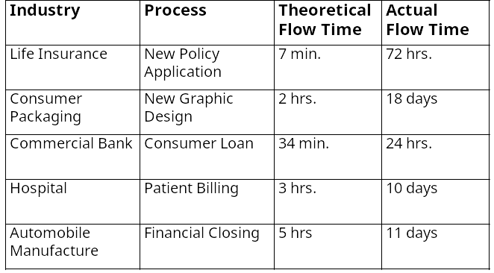
Flow Times in White Collar Processes
Why are the flow times so long?
Notes:
Value-added time vs. non-value-added time

Slide 10
Time-Base Competition
Time: an important source of competitive advantage
  Fast introduction of new products/services
  Fast and on-time delivery of existing products/services
Don’t sell what you produce, produce what sells.
Response time is an important service attribute.
Process flow time determines the capability of a firm in time-based competition.

Slide 11

A Perfect Service Process
Customer
Getting served on arrival
Inter-arrival time is the time between two consecutive arrivals.
Service (or processing) time is the time taken to serve a customer.
Inter-arrival time = service time = 6 minutes.
Arrival rate = 10 customers per hour.
Service rate = 10 customers per hour.
There is one server.
No queue and an arriving customer get serviced without any delay.

Slide 12
A Service Process with Variability
customer
queue
server with another customer
Average arrival rate = average service rate = 10 customers per hour.
There is one server.
However, inter-arrival times and service times are random.
What happens if 15 customers arrive in a given hour?
What if the service time of a customer is much longer than 6 minutes?

Slide 13
1
2
3
4
5
1
2
3
4
5
1
2
3
4
5
1
2
3
4
5
0
1
2
1
0
1
0
0

Slide 14
Effect of Variability: Inter-Arrival Times
Average arrival rate = 8 per hour, average service rate = 10 per hour.
With one server, utilization = 80%.
Service time is fixed at 6 minutes but inter-arrival times are random.
Case1: 2 customers arrive in the first hour.
14 customers arrive in the second hour.
Case2: 6 customers arrive in the first hour.
10 customers arrive in the second hour.
Which case is more likely to have a longer waiting time?

Slide 15
Effect of Variability: Service Times
Average arrival rate = 8 per hour, average service rate = 10 per hour.
With one server, utilization = 80%.
Inter-arrival time is fixed at 7.5 minutes but service times are random.
Case1: The service times of two consecutive customers are 8 and 4 minutes, respectively.
Case2: The service times of two consecutive customers are 10 and 2 minutes, respectively.
Which case is more likely to have a longer waiting time?

Slide 16
Characterizing the Variability of the Process
25%
100%
90%
20%
80%
15%
60%
Probability
10%
40%
The service time probability distribution
5%
20%
0%
0%
0
10
20
30
40
50
60
70
80
90
100
110
120
130
140
150
160
170
180
190
More
Service Time
30%
100%
90%
25%
80%
20%
70%
60%
Probability
15%
50%
40%
10%
30%
The inter-arrival time probability distribution
5%
20%
10%
0%
0%
0
10
20
30
40
50
60
70
80
90
100
110
120
130
140
150
160
170
180
190
More
Inter-arrival Time

Slide 17
Effect of Utilization
Avg. arrival rate = 8 per hour and there is only one server.
Both inter-arrival times and service times are random.
Case1: avg. service time = 6 minutes, utilization = 80%.
Case2: avg. service time = 3 minutes, utilization = 40%.
Which case is more likely to have a longer waiting time?

Slide 18
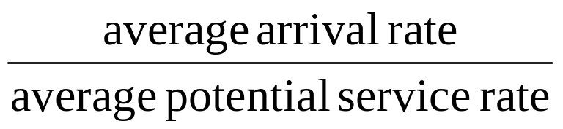
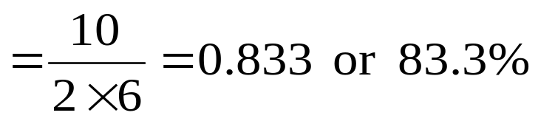
Server Utilization
Server utilization =
Example:
  There are 2 servers. The average arrival rate is 10 per hour. The average service time is 10 minutes, so each server can serve an average of 6 customers per hour.
  Server utilization

Slide 19
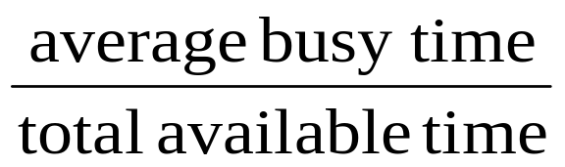
Server Utilization:
An Alternative Calculation
Server utilization is the average fraction of time a server is busy.
Server utilization =
Example:
  The average arrival rate is 10 per hour. Each customer demands an average of 10 minutes of service, so for a given hour, there is 100 minute or 1.667 hours of work on average. There are 2 servers, each has an hour available, so total available time is 2 hours.
  Server utilization is 1.667/2 = 83.3%.

Slide 20
Waiting Time, Variability and Utilization
When there is no variability in inter-arrival and service times, a queue will form only when the arrival rate is greater than the service rate.
When there is variability in inter-arrival and/or service times, a queue will form even when the average arrival rate is lower than the average service rate.
Service time depends on the service requirement of the customer as well as the processing capacity of the server.
In general, more variability and higher utilization mean a longer queue and longer waiting time.

Slide 21
When Will We Have a Queue?
Queues build up even if the average arrival rate is smaller than the average service rate, under two conditions:
  Inter-arrival or service times are variable, and
  Variability between the two times is not synchronized.
    Negative variation: service time > next inter-arrival time
    Positive variation: service time < next inter-arrival time
Positive and negative variations do not cancel out.

Slide 22
1
2
3
4
5
1
2
3
4
5
1
2
3
4
5
1
2
3
4
5
0
1
2
1
0
1
0
0
Negative Variation
Positive Variation

Slide 23
A Simple Queueing Process Model
Queue
“buffer” size K
Incoming customers
Servers
providing
service
Departing customers
Customers
on hold
Blocked customers
(when the buffer is full)

Slide 24
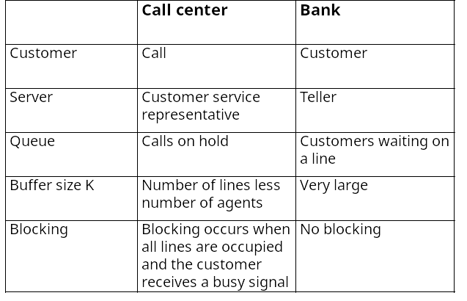
Examples of the Queueing Process Model

Slide 25
Elements of a Queueing Model
Inputs
  Average arrival rate R_{i} / inter-arrival time distribution
  Average service (processing) time T_{p} / service time distribution
  or service rate μ = 1/T_{p}
System structure
  Number of servers c (so maximum service rate = c/T_{p})
  Maximum queue capacity (i.e., buffer capacity) K
Operating control policies
  Queue-service discipline: FCFS, SIRO, LCFS
Notes:
Service in random order

Slide 26
Average Performance Measures
Customer service
  Average waiting time in queue T_{i} or total time in process T
  Probability of blocking P_{b}
Sales
  Throughput R = R_{i} x (1-P_{b})
Costs
  Capacity utilization ρ = R/(c/T_{p}) = (RT_{p})/c
  Average queue length I_{i} or total number in process I
  Average no. of customers in service I_{p} = I – I_{i}

Slide 27
Useful Relationships
T = T_{i} + T_{p}
Time in process = time in queue + time in service
I = I_{i} + I_{p}
no. in process = no. in queue + no. in service
I_{p} = RT_{p} = ρc = average number of busy servers
I = RT
I_{i} = RT_{i}

Slide 28
Recall of Little’s Law
Inventory = flow rate x flow time
Example: The average arrival rate to a health care facility is 50 patients per month and the average length of stay is 2 months. The average number of patients in the system is 50 x 2 = 100.
The Little’s Law applies to the whole system or any part of the system, to all customers or any type of customers.

Slide 29
Throughput-Delay Curve
Average
Flow
Time T
Variability
Increases
T_{p}
Utilization (ρ)
100%
ρ
Trade-off between asset utilization and service quality.
Notes:
Examples
Cars driven to central London has to pay 5 pounds “congestion fee” starting 17 Feb 03.

Slide 30
How to reduce waiting?
Variability reduction + Safety capacity
How to reduce system variability?
Safety Capacity = capacity carried in excess of expected demand to cover for system variability
  it provides a safety net against higher than expected arrivals or services and reduces waiting time
To have sufficient capacity at all times may not be practical.
  wait no more than 4 minutes 95% of the time.

Slide 31
Random Arrivals – Poisson Process
During a particular period, customers arrive at random, independently of one another, at a constant average rate.
In a Poisson arrival process, the inter-arrival time follows an exponential distribution. The number of arrivals during a certain interval follows a Poisson distribution.
For a Poisson random variable, the standard deviation is the square root of the average. For example, if the average is 16, the standard deviation is equal to 4. (16 – 3x4 = 4, 16 + 3x4 = 28)
Suppose the average arrival rate is 16 per hour. The actual arrivals will vary from hour to hour. In fact, we can expect to see anywhere from 4 to 28 arrivals in a particular hour (with probability 99.7%)!
This random arrival pattern is called Poisson arrival process after the French mathematician who derived it.

Slide 32
Exponential Distribution:
30%
100%
90%
25%
80%
20%
70%
60%
15%
50%
Probability
40%
10%
30%
5%
20%
10%
0%
0%
0
10
20
30
40
50
60
70
80
90
100
110
120
130
140
150
160
170
180
190
More
Exponential distribution: The standard deviation is equal to the mean.

Slide 33
Notation
X/X/X/X
Buffer size
Number of servers
Service time distribution
Arrival distribution
Model 1: M/G/1
Model 2: M/M/1
Model 3: M/M/c
Model 4: M/M/c/K

Slide 34
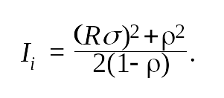
Model 1:
Single Server, Poisson Arrivals, Infinite Buffer
Utilization ρ = RT_{P}. Condition for a stable system: ρ < 1.
(Optional) Queue length formula:
where σ is the standard deviation of service time.
The formula is exact and does not depend on the service time distribution other than through σ.
Given I_{i}, other measures, such as T_{i}, I, T, can be derived.
Be sure to use consistent units for R and T_{p}.
File “Qmmc.xls”, sheet “MG1”

Slide 35
Example
The relevant data of two service systems are given below:
System #1: T_{p} = 3.0 minutes, σ = 2.1 minutes.
System #2: T_{p} = 3.1 minutes, σ = 1.0 minutes.
Customers of each system arrive randomly at an average rate of 15 per hour.
Which system has a longer waiting line?
Notes:
Waiting line in system 1: 1.6762;
Waiting line in system 2: 1.4736

Slide 36
MRT Weeds out Trouble Makers
During the Easter weekend, KCR, which runs train service from Hung Hom through Kowloon Tong to Lo Wu, imposed a fine of $100 for each passenger who did not use the correct ticket. Why?
What is the impact of the trouble makers on the average delay?

Slide 37
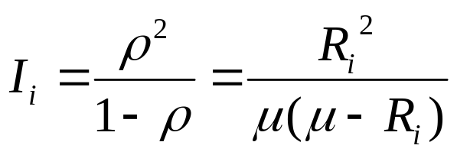
Model 2: (A special case of Model 1)
Single Server, Poisson Arrivals, Infinite Buffer
Exponential Service Time Distribution
Utilization ρ = RT_{P}. Condition for a stable system: ρ < 1.
Queue length formula:
The formula is exact and assumes exponential service time.
Given I_{i}, other measures, such as T_{i}, I, T, can be derived. For example, T_{i} = I_{i} /R.
Be sure to use consistent units for R and T_{p}.
File “Qmmc.xls”, sheet “MMc”
Notes:
Mu is the service rate

Slide 38

M/M/1 queue
R: arrival rate; T_{p}: processing time;
Utilization = RT_{p}
Average no. in service = RTp
Percentage of time the server is idle = 1-RT_{p}
Average no. in the system =
Average no. in queue = average no. in system – average no. in service
Total time in system = no. in the system /R
Waiting time in queue = no. in queue /R

Slide 39
Students arrive at the Administrative Service Office at an average of one every 15 minutes, and their requests take on average 10 minutes to be processed. The service counter is staffed by only one clerk, Judy, who works eight hours per day. Assume Poisson arrivals and exponential service times.
a. What percentage of time is Judy idle?
b. How much time, on average, does a student spend waiting in line?
c. How long is the (waiting) line on average?

